Slide 1
Data Science & Machine Learning
Senior Mentor- Sachin Saxena

Slide 2
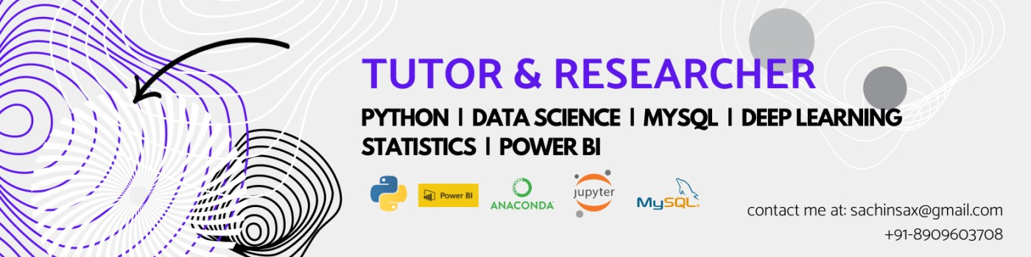

Senior Mentor at Edunock Sachin Saxena Sr Data Scientist Gavs Technology, Chennai

Slide 3
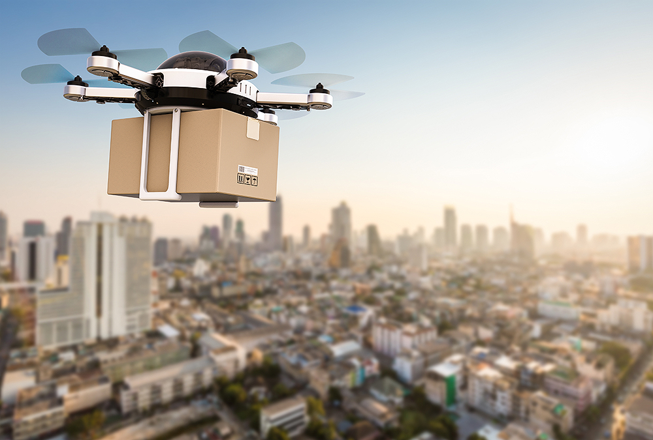
Why Data science? Amazon!!

Slide 4
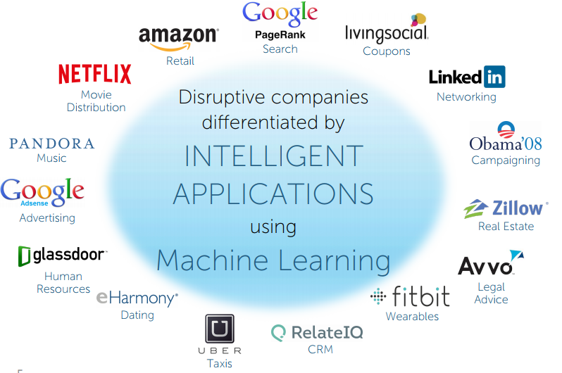
Why Data science?

Slide 5
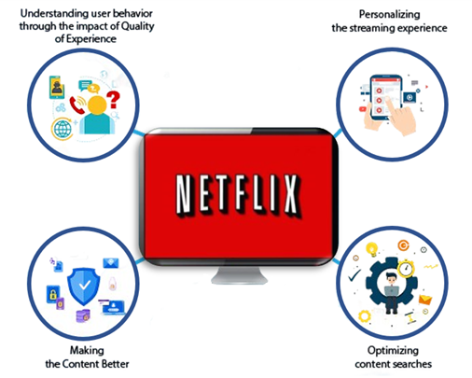
What is Data science?

Slide 6
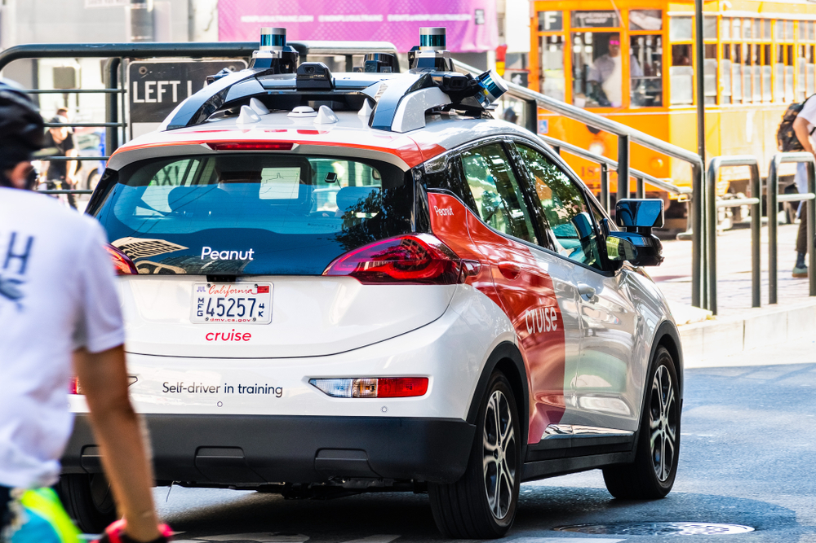
Where Data science ?

Slide 7
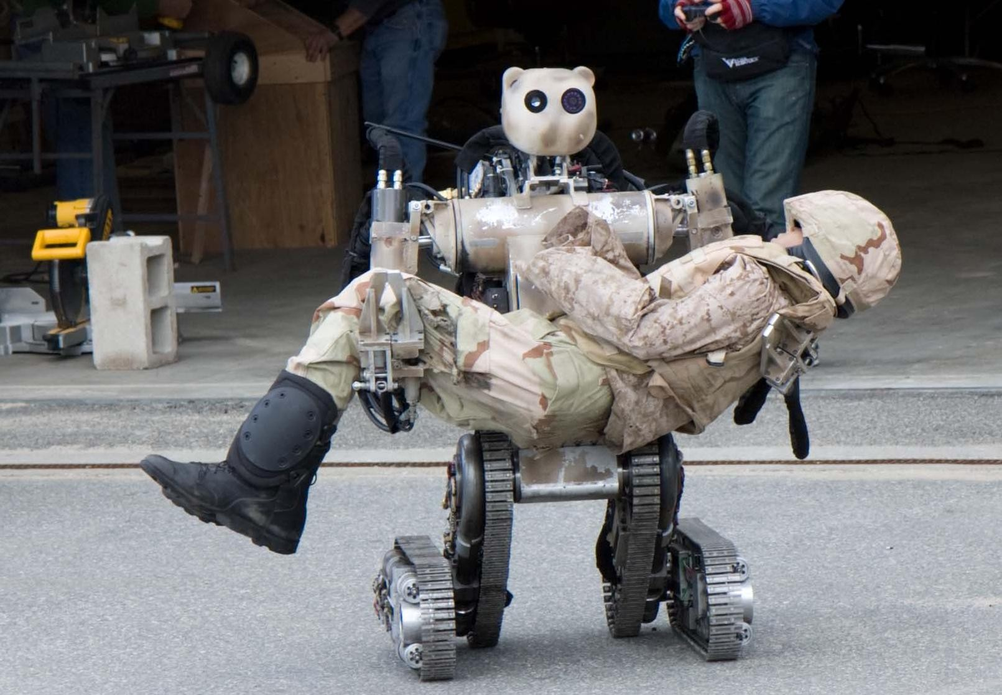
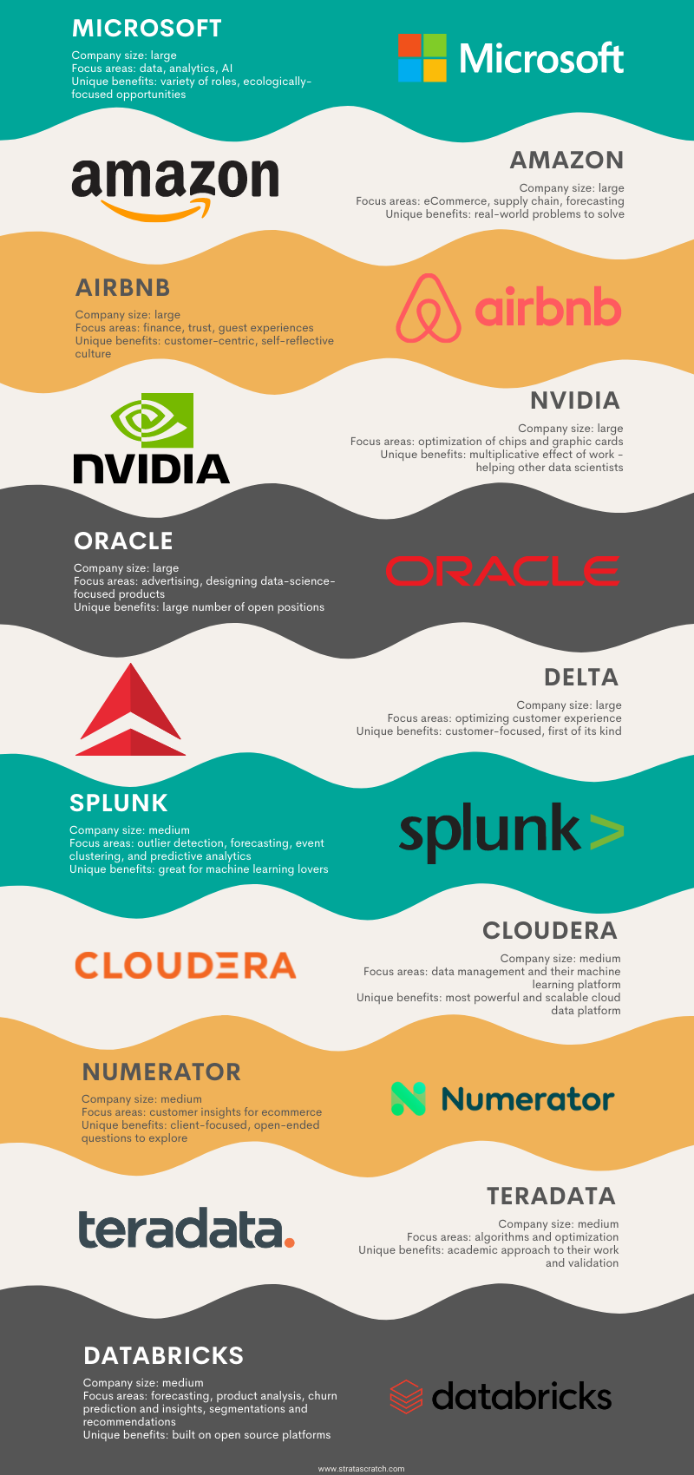
How Data Science is solving real world problems??

Slide 8
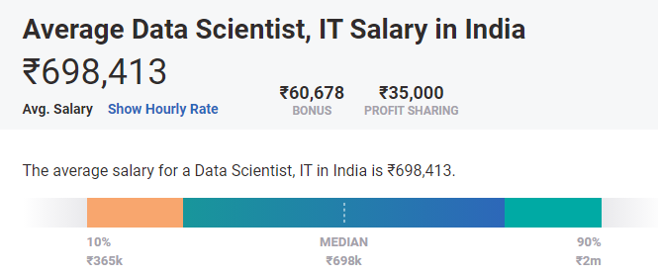
Demand for Data science

Slide 9
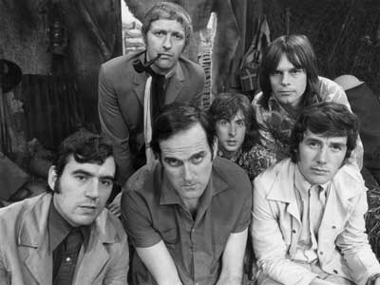
Python! Introduction..
Created in 1991 by Guido van Rossum (now at Google)
Named for Monty Python
Useful as a scripting language
script: A small program meant for
one-time use
Targeted towards small to medium
sized projects
Used by:
Google, Yahoo!, Youtube
Many Linux distributions
Games and apps (e.g. Eve Online)

Slide 10





Data Science is used everywhere!

Slide 11
Installing Python
Windows:
Download Python from http://www.python.org
Install Python.
Run Idle from the Start Menu.
Mac OS X:
Python is already installed.
Open a terminal and run python or run Idle from Finder.
Linux:
Chances are you already have Python installed. To check, run python from the terminal.
If not, install from your distribution's package system.
Note: For step by step installation instructions, see the course web site.

Slide 12
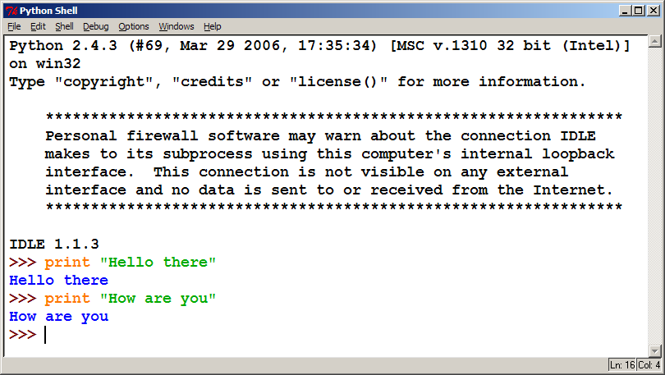
The Python Interpreter
Allows you to type commands one-at-a-time and see results A great way to explore Python's syntax
Repeat previous command: Alt+P

Slide 13
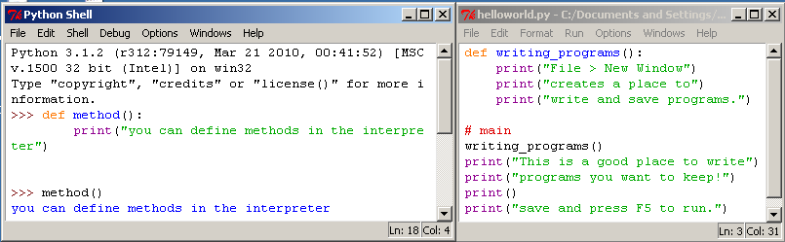
How to run Python Windows
Run IDLE to use the interpret
Open a new window in IDLE to write and save programs

Slide 14
Python 2.x vs Python 3.x
We will be using Python 3 for this course
Sometimes we may refer to Python 2
The differences are minimal
How to | Python 2.x | Python 3.x
print text | print “text” | print(“text”)
print a blank line | print | print()

Slide 15

Other platforms to Run Python Code:
Google Colab
Kaggle Online complier
Pycharm
Spyder
https://www.anaconda.com/
https://www.programiz.com/python-programming/online-compiler/
https://www.onlinegdb.com/online_python_compiler
https://www.w3schools.com/python/python_compiler.asp
https://www.online-python.com/
https://www.tutorialspoint.com/execute_python_online.php

Slide 16
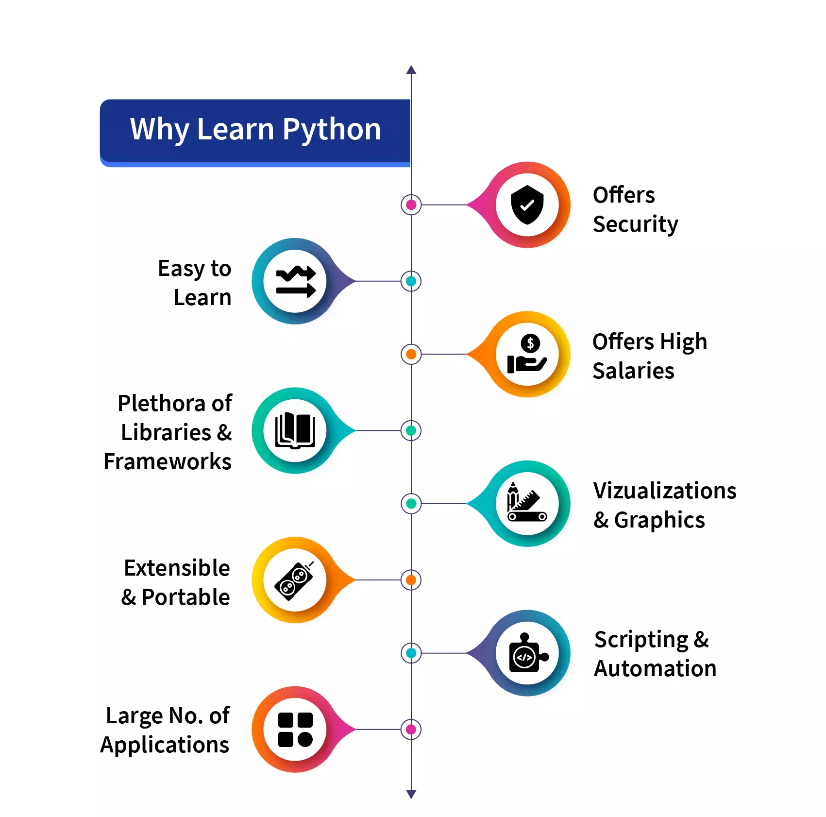
Why Learn Python
Image courtesy: https://scaler.com/topics/images/why-learn-python.webp

Slide 17
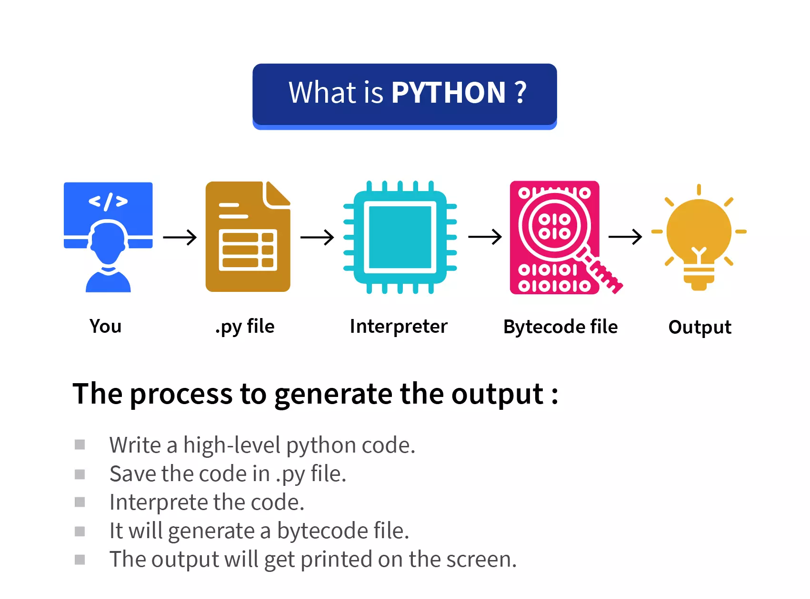
How Python works?
Image courtesy: https://scaler.com/topics/images/what-is-python.webp

Slide 18
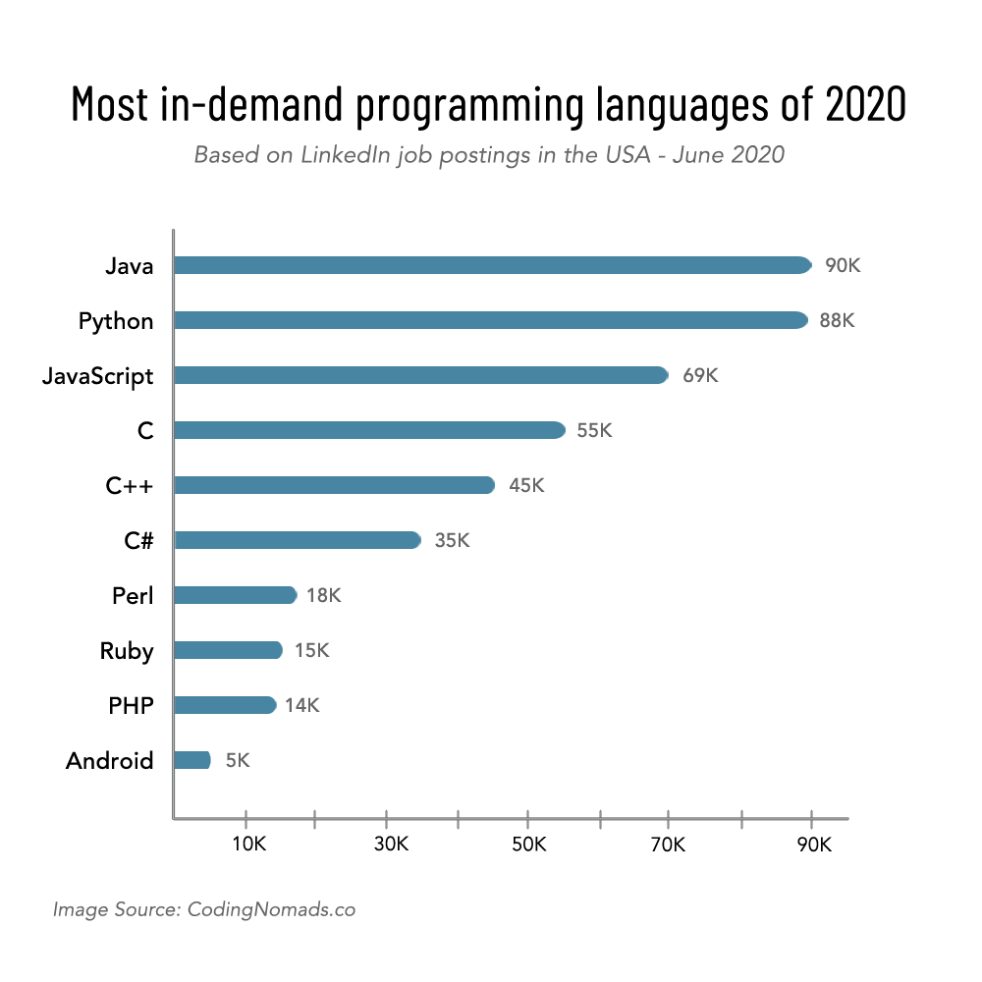
Why Python?

Slide 19
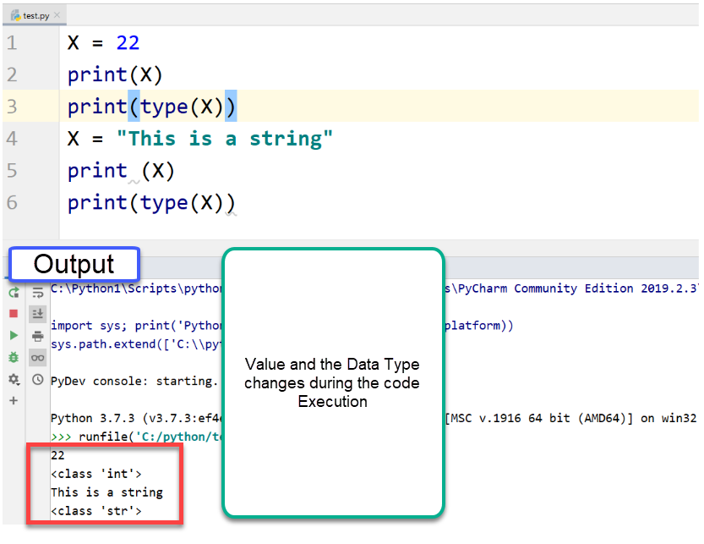
Variables in Python

Slide 20
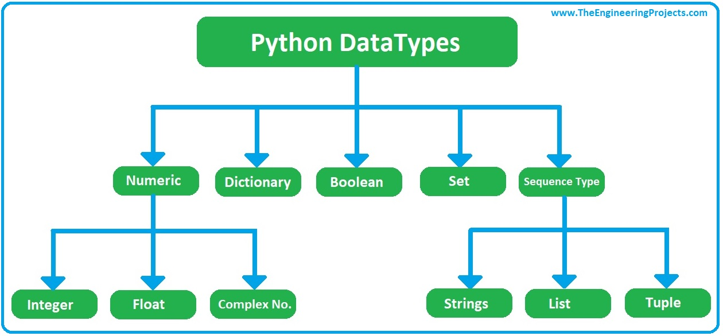
Variables in Python

Slide 21
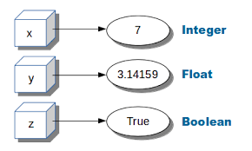
Variables in Python

Slide 22
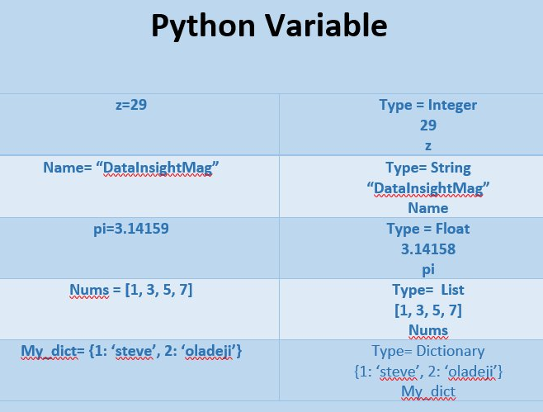
Variables in Python

Slide 23
Basics of Python for data Science( pandas, Numpy, Matplotlib)

Slide 24
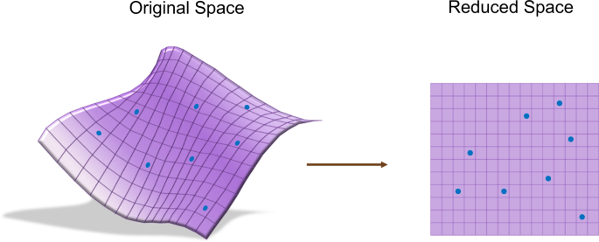
What is Dimensionality reduction concept ?: PCA

Slide 25
What is Dimensionality reduction concept ? Features: Date of purchase Type of product purchased Price of the product Quantity purchased Customer ID Location of the store where the purchase was made In a dataset of medical images, the features might include: Pixel values at each location in the image Contrast or brightness of the image Size of the image Orientation of the image

Slide 26
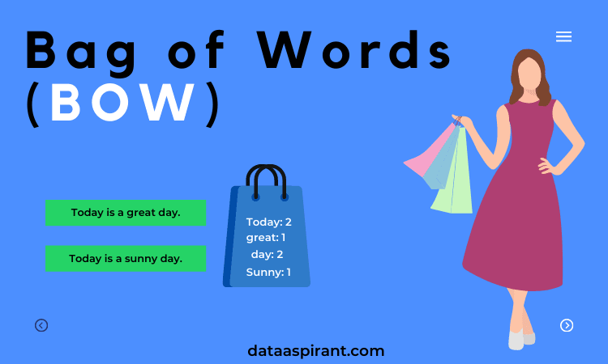
NLP: Bag of words

Slide 27
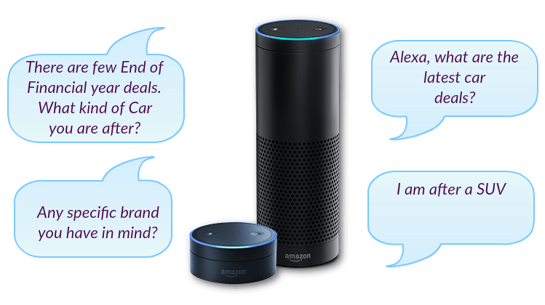
Bag of words: Alexa

Slide 28
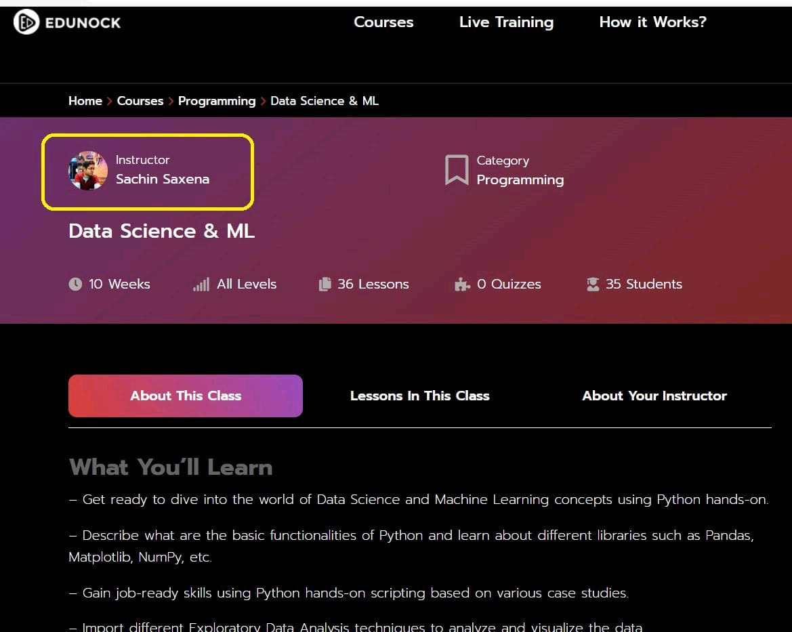

Slide 29
Thanks !!! Any Query?

